Slide 1
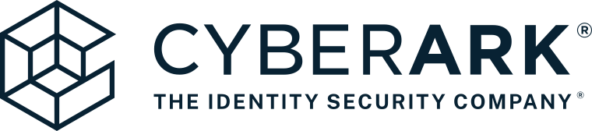
Presented by: Hussein Sbeiti, Jon Fernandez Ayele Kouevidjin, Chinyere Brown-McVitie

Slide 2
Agenda
Historical Background
Year 1
Year 2
Year 3
Zero Day Exploit
Laws & Regulations
Wrap up – Conclusion

Slide 3

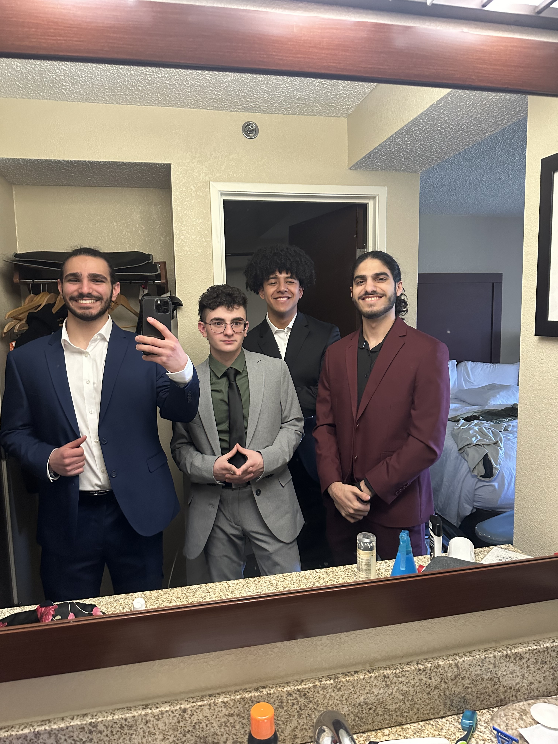


Who We Are
Hussein Sbeiti
Jon Fernandez
Chinyere Brown-McVitie
Ayele Kouevidjin
Notes:
Jon – Chief Strategy Officer (CSO)
Co-leads the design of CyberArk’s 3-year cybersecurity strategy, focusing on innovation, market positioning, and staying ahead of emerging threats.
Hussein – Chief Information Security Officer (CISO)
Co-develops the long-term security roadmap, driving quantum-resilient solutions, AI-integrated defenses, and ethical response planning to ensure CyberArk’s leadership in the PAM space.
Ayele – Chief Financial Officer (CFO)
Oversees financial planning and resource allocation, ensuring the strategy remains cost-effective while maximizing operational impact and return on investment.
Chinyere – Chief Compliance Officer (CCO)
Leads legal and regulatory strategy, ensuring that CyberArk’s cybersecurity initiatives align with global compliance standards and foster long-term client trust.

Slide 4


Historical Background
From securing identities to shaping the future of cybersecurity

Slide 5
Historical Background
1999
Udi Mokady and Alon Cohen found CyberArk, introducing the concept of a “digital vault”
2004
Shift in focus from general secure storage to PAM (Privileged Access Management)
2006
CyberArk expands globally, setting up sales channels in Europe and Asia
2014
CyberArk goes public (IPO) on NASDAQ at a valuation of $885 million
2019
Expands SaaS and cloud-native PAM solutions, with partnerships with AWS, Microsoft Azure, and Google Cloud
2020
The pandemic accelerates cloud adoption, increasing demand for zero-trust architectures
2022
CyberArk transitions to a subscription-based model for all new business
2025
CyberArk strengthens identity security with AI-powered threat detection and automation tools

Slide 6
Year 1
Laying the foundation for secure, scalable, and strategic growth
Notes:
Thank you ayele , for year one we wanted to focus on laying the groundwork of our study.

Slide 7
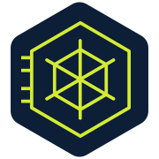
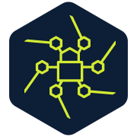
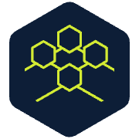
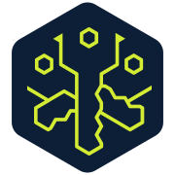
Year 1: Foundation and Trust Rebuilding
Form dedicated cybersecurity task forces including incident response, threat hunting, and vulnerability management teams to immediately improve internal readiness and reduce exposure to active threats
Implement scalable quantum computing infrastructure to test and prepare for quantum-era threats while beginning internal integration of post-quantum cryptographic algorithms into core PAM workflows
Launch and operationalize a Zero-Day Vulnerability Response Plan that includes rapid detection, internal communication protocols, ethical disclosure processes, and customer-facing mitigation playbooks
Rebuild client trust and reinforce CyberArk’s security reputation through transparent third-party audits, improved service-level agreements (SLAs), and consistent communication around new security and compliance upgrades
Notes:
We formed specialized cybersecurity teams for incident response, threat hunting, and vulnerability management. We invested in scalable quantum computing infrastructure and began integrating post-quantum cryptography into our PAM workflows. A Zero-Day Vulnerability Response Plan was launched to ensure rapid detection, structured communication, and ethical disclosure. Finally, we worked to rebuild trust through transparent third-party audits and more robust SLAs.

Slide 8
Year 2
Enabling secure, scalable growth through seamless integration
Notes:
For year two we wanted to shift our focus from a good foundation to large scale growth.

Slide 9
Year 2: Expansion and Integration
Expand and integrate quantum-safe cryptography and AI-driven threat analytics into CyberArk’s Vault, Session Manager, and Endpoint Privilege Manager to enhance proactive defense capabilities and reduce false positives
Scale up cloud and hybrid infrastructure protection by embedding PAM controls across major platforms (AWS, Azure, GCP) and enabling secure remote access with Just-in-Time provisioning
Develop and formalize strategic partnerships and industry alliances with cloud providers, security vendors, and regulatory bodies to promote interoperability and drive adoption of CyberArk’s zero-trust innovations
Enhance go-to-market strategy and global market presence by tailoring solutions for underserved sectors, expanding partner channels, and targeting emerging markets with localized compliance offerings.
Notes:
Quantum-safe cryptography and AI-driven threat analytics were embedded into core CyberArk tools like Vault, Session Manager, and Endpoint Privilege Manager. We enhanced cloud security by embedding PAM controls across AWS, Azure, and GCP, and developed partnerships with regulatory bodies and industry leaders to expand our market and tailor localized compliance offerings.

Slide 10
Year 3
Leading the future through innovation and strategic resilience

Slide 11
Year 3: Innovation and Strategic Resilience
Solidify CyberArk’s position as the industry standard by contributing to open-source security frameworks, leading global cybersecurity initiatives, and helping define post-quantum PAM best practices
Achieve operational excellence through automation and intelligence, using machine learning to optimize incident detection, reduce human error, and implement real-time risk scoring for privileged access
Execute strategic acquisitions and R&D investments to fill capability gaps in adjacent areas like CI/CD pipeline security, DevSecOps integrations, and privileged access in OT/ICS systems.
Future-proof infrastructure and product lines by preparing for evolving regulatory demands, geopolitical risk, and advanced persistent threats — ensuring CyberArk’s long-term resilience and customer trust.
Notes:
In our third year, we doubled down on automation and industry leadership. We contributed to global cybersecurity frameworks, optimized incident detection using AI and machine learning, and invested in strategic acquisitions to cover areas like CI/CD pipeline security and OT/ICS integration. We also future-proofed infrastructure to handle geopolitical risk, regulatory changes, and persistent threats. Ensuring CyberArks long term resilience and building back our consumer trust. Now that we've outlined our strategic path forward, Hussein will address a recent critical security event: the zero-day PAM session token hijacking exploit, and how we strategically managed this incident using the NIST Cybersecurity Framework.

Slide 12
Zero Day Exploit
Anticipating threats, responding with precision, and building resilient defense
Notes:
thank you jon no lets move foward and analyze the zero day exploit that was discovered In cyberarks PAM systems

Slide 13
Zero Day Exploit: PAM Session Token Hijacking
Exploit Method:
A malicious insider or APT exploits a race condition during session initiation.
Gains access to valid session tokens via man-in-the-middle (MITM) or through endpoint memory scraping.
Reuses the token to impersonate a privileged user without needing credentials or MFA.
Impact:
Full access to vaulted credentials, session recordings, and PAM audit logs.
Persistence across sessions without detection.
Bypasses behavioral analytics if the attacker mimics legitimate workflows.
Why It’s Critical:
Directly undermines CyberArk’s core value proposition: secure and auditable privileged access
Could lead to high-profile customer breaches, regulatory scrutiny, and brand trust erosion.
Difficult to detect without deep session integrity checks or behavioral anomaly detection.
Notes:
A recent zero-day exploit has emerged: session token hijacking within PAM systems. This vulnerability allows attackers to hijack authenticated sessions, bypassing traditional security layers. Our analysis shows that if left unaddressed, this could cost CyberArk and its clients up to $40 million per breach in financial, regulatory, and reputational damage.
We acted swiftly by activating our Zero-Day Vulnerability Response Plan. Internally, we launched secure containment efforts, developed patches, and ran forensics on affected systems. Externally, we prepared mitigation playbooks for customers.
**Ethical Dilemma & Disclosure Strategy**
This event presented a major ethical decision: Should we disclose the vulnerability immediately and risk tipping off attackers? Or work on a fix quietly and inform clients after a solution is ready? Our answer is a hybrid approach:
1. Covert response and patch development.
2. Early notification to key partners under NDA.
3. Public disclosure after patch deployment.
4. Discreet collaboration with government agencies such as DHS and CISA to monitor threat movement while preserving customer privacy

Slide 14
NIST Framework in Action – CyberArk’s Strategic Response
🧠 1. Identify
🔍 3. Detect
Map and classify all PSM systems and privileged assets
Evaluate risk exposure from CVE-2024-39708
Analyze vendor and threat intelligence sources (e.g., dark web activity)
🛡️ 2. Protect
Redesign session token validation to prevent hijacking
Apply quantum-resistant entropy for future-proofing
Enhance session monitoring and access control policies
Monitor for anomalies in session behavior and access patterns
Leverage dark web intel and APT behavior tracking
Integrate AI/ML into threat detection pipelines
Notes:
To effectively manage the CVE-2024-39708 zero-day exploit, our response was structured around the five core functions of the NIST Cybersecurity Framework (CSF) — Identify, Protect, Detect, Respond, and Recover. This provided a clear, actionable methodology that enabled us to mitigate risk with speed, precision, and long-term resilience.
• Identify: We conducted a comprehensive system-wide risk assessment across all privileged access points and identity layers. This included evaluating asset vulnerabilities, third-party integrations, and potential attack vectors within customer environments. Our team mapped out exposure levels based on session token flow and access patterns, enabling rapid prioritization of high-risk systems.
• Protect: We implemented urgent updates to session token encryption within the Privileged Access Management (PAM) architecture. Security policies were tightened, multi-factor authentication was enforced for all elevated accounts, and temporary session expiry thresholds were reduced. Simultaneously, customers were issued detailed guidance to harden PAM configurations across hybrid environments.
• Detect: Leveraging AI-driven behavioral analytics and advanced SIEM integration, we identified anomalous session activities and unauthorized token replay attempts across the infrastructure. These tools enabled early detection of lateral movement attempts and highlighted potentially compromised endpoints in real-time.
• Respond: Our incident response task force was immediately activated, including cross-functional teams from cybersecurity, engineering, legal, and client relations. Containment protocols were executed across affected systems, threat intelligence sharing was initiated with global partners, and a direct communication channel was opened with impacted clients. We also worked with internal red teams to simulate further exploit paths and preempt escalation.
• Recover: Post-incident, we established continuous monitoring of patched systems and enforced audit logging for all PAM activity. Affected client integrations were reviewed and revalidated to ensure integrity. Lessons learned were compiled into a formal after-action report, and we launched a roadmap for enhanced PAM resilience, including future-proofing strategies against session token hijacking.
Why This Approach Worked
This structured, NIST-aligned strategy enabled us to not only contain the exploit but also strengthen our overall security posture. By embedding threat intelligence, automation, and governance throughout the lifecycle of our response, we ensured clarity in decision-making and minimized business disruption for both CyberArk and our customers.

Slide 15
NIST Framework in Action – Incident Response & Recovery
🚨 4. Respond
• Activate emergency IR team and threat analysis workflows
• Engage bug bounty researcher and validate exploit
• Quietly develop and test patch before public disclosure
Notify key customers under NDA; prep external comms plan
🧯 5. Recover
• Publish public disclosure and support documentation
• Assist customers with patch rollout and mitigation
• Conduct post-incident review and implement lessons learned
Rebuild trust through transparency and industry leadership
Notes:
• Respond: Our incident response task force was immediately activated, including cross-functional teams from cybersecurity, engineering, legal, and client relations. Containment protocols were executed across affected systems, threat intelligence sharing was initiated with global partners, and a direct communication channel was opened with impacted clients. We also worked with internal red teams to simulate further exploit paths and preempt escalation.
• Recover: Post-incident, we established continuous monitoring of patched systems and enforced audit logging for all PAM activity. Affected client integrations were reviewed and revalidated to ensure integrity. Lessons learned were compiled into a formal after-action report, and we launched a roadmap for enhanced PAM resilience, including future-proofing strategies against session token hijacking.
Why This Approach Worked
This structured, NIST-aligned strategy enabled us to not only contain the exploit but also strengthen our overall security posture. By embedding threat intelligence, automation, and governance throughout the lifecycle of our response, we ensured clarity in decision-making and minimized business disruption for both CyberArk and our customers.
"Having addressed our technical and strategic response to this incident, I'll now hand it over to Chinyere, who will cover our compliance with relevant laws and regulations."

Slide 16
Laws and Regulations
Navigating the evolving cybersecurity landscape with compliance, clarity, and confidence

Slide 17

Laws & Regulations
Global & National Compliance Frameworks
1. GDPR (EU General Data Protection Regulation)
Requires strong protection for personal data of EU citizens
CyberArk must secure sensitive data and user identities
2. SOX (Sarbanes-Oxley Act – U.S.)
Requires strong internal controls over financial reporting
PAM is essential for auditability & accountability in financial systems
3. FISMA (Federal Information Security Modernization Act)
U.S. federal agencies must secure IT systems
PAM aligns with CDM (Continuous Diagnostics & Mitigation) requirements
International Cybersecurity Standards
ISO/IEC 27001
Global standard for Information Security Management Systems (ISMS)
CyberArk is ISO 27001 certified, proving best-practice security

Slide 18
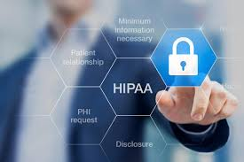
Laws & Regulations
Industry-Specific Regulations
1. GLBA (Gramm-Leach-Bliley Act)
Applies to financial institutions handling consumer financial data
Requires least privilege access & privileged activity monitoring
2. SWIFT CSCF (Banking/Finance)
Protects global financial messaging infrastructure
CyberArk supports secure access for SWIFT compliance
3. HIPAA (Healthcare – U.S.)
Safeguards patient data and medical records
PAM tools support HIPAA-compliant access controls
U.S. Federal Cybersecurity Guidelines
NIST Framework
Cybersecurity best practices and risk management
CyberArk aligns with:
NIST SP 800-63 (Digital Identity Guidelines)
NIST SP 800-207 (Zero Trust Architecture)

Slide 19
Recommendations
Driving decisions with data, strategy, and foresight

Slide 20
Our Recommendations
1. Deploy a Quantum Computer to Drive AI-Powered Security
Acquire and operationalize a quantum computer to simulate advanced threats, train AI models, and enhance breach detection. Use it to rebuild trust post-zero-day exploit and lay the foundation for future-proof security.
2. Integrate Quantum-Safe Cryptography Across All Systems
Embed post-quantum encryption (e.g. Kyber, SPHINCS+) into PAM, MFA, and cloud infrastructure. Protect machine identities, sessions, and secrets with quantum-resilient algorithms.
3. Establish CyberArk as the Industry Leader in Quantum-Enhanced Security
Lead global standards, form strategic partnerships, and publish cutting-edge research. Build quantum-first features into every product and set the benchmark for future cybersecurity.

Slide 21
Thank you

Slide 22
Citations
Harvard Business School Case – “CyberArk: Protecting the Keys to the IT Kingdom”
https://hbsp.harvard.edu/product/724406-PDF-ENG
CyberArk Official Website
https://www.cyberark.com
CyberArk Investor Relations & Reports
https://investors.cyberark.com/
CyberArk Blog: Threat Research & Updates
https://www.cyberark.com/resources/threat-research-blog
MITRE CVE Directory – CVE-2024-39708
https://cve.mitre.org/cgi-bin/cvename.cgi?name=CVE-2024-39708
NIST National Vulnerability Database (NVD)
https://nvd.nist.gov/vuln/detail/CVE-2024-39708
NIST Cybersecurity Framework (CSF)
https://www.nist.gov/cyberframework
General Data Protection Regulation (GDPR)
https://gdpr.eu/
Sarbanes-Oxley (SOX) Compliance
https://www.soxlaw.com/
HIPAA Security Rule
https://www.hhs.gov/hipaa/for-professionals/security/index.html
Gartner Magic Quadrant for PAM (2023/2024)
https://www.gartner.com/en/documents/3988084
Forrester Wave: Privileged Identity Management, Q4 2023
https://www.forrester.com/report/the-forrester-wave-privileged-identity-management-q4-2023/RES178041
BeyondTrust (Competitor Website)
https://www.beyondtrust.com
ThycoticCentrify (now Delinea)
https://www.delinea.com
MITRE ATT&CK Framework
https://attack.mitre.org
CISA – Zero Trust Maturity Model
https://www.cisa.gov/resources-tools/resources/zero-trust-maturity-model
Splunk Security Blog
https://www.splunk.com/en_us/blog/security.html

Slide 23
Zero Day Exploit Questions & Solutions
❓ Should CyberArk covertly work on a fix and release a patch before disclosure?
Yes – Patch First, Disclosure After
Immediate public disclosure without a patch could accelerate exploitation by threat actors.
Covert development allows CyberArk to act swiftly while minimizing risk to customers.
Early communication to select customers (under NDA) ensures tiered protection without mass panic.

Slide 24
Zero Day Exploit Questions & Solutions
❓ How does CyberArk balance transparency and corporate responsibility?
Balanced, Phased Transparency Approach
Short-term confidentiality protects customers until a fix is available.
Once the patch is ready, CyberArk will:
Publicly disclose the exploit, timeline, and mitigation strategy.
Offer technical support and transparent FAQs.
Outcome: Preserves trust while demonstrating leadership in responsible vulnerability handling

Slide 25
Zero Day Exploit Questions & Solutions
❓ Should CyberArk involve government or intelligence agencies?
Quietly consult trusted national cybersecurity agencies (e.g., Israel CERT, CISA) to:
Share threat intelligence
Validate scope of threat
Monitor potential state-level misuse
Avoid turning over operational control or exploit samples unless legally mandated
Maintain private sector autonomy while benefiting from global defense intelligence.
Limited, Strategic Cooperation – No Operational Control
Notes:
Ultimately, our hybrid strategy balanced customer protection, ethical responsibility, and strategic transparency—delivering security leadership without compromising trust.

Slide 26
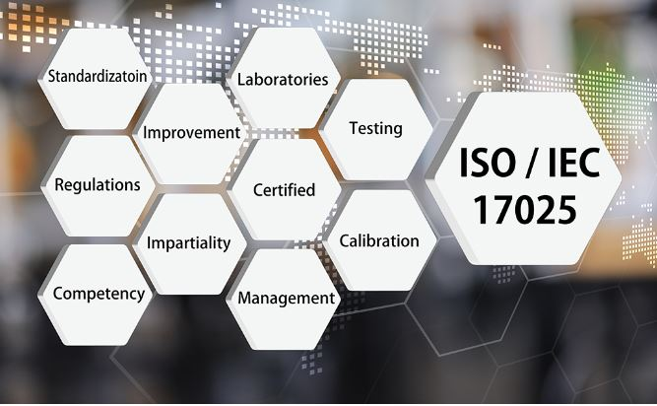
Laws & Regulations
International Cybersecurity Standards
ISO/IEC 27001
Global standard for Information Security Management Systems (ISMS)
CyberArk is ISO 27001 certified, proving best-practice security
U.S. Federal Cybersecurity Guidelines
NIST Framework
Cybersecurity best practices and risk management
CyberArk aligns with:
NIST SP 800-63 (Digital Identity Guidelines)
NIST SP 800-207 (Zero Trust Architecture)

